Slide 1

Second Year Bachelor of Technology
In
Electronics and Telecommunication Engineering
School of Electrical Engineering
Mrs. Savita Pawar
(Course Mentor)
S207043 Akshay Kapase (224)
S207080 Dhiraj Patil (155)
S2070 Shrihari Eknathe (139)
S207120 Shrikant Deshmukh(115)

Slide 2
Digital IR Thermometer
With Pulse Oximeter
Minor Project

Slide 3
Introduction
Nowadays world is under endangered situation due to current COVID-19 pandemic. Our main goal is to design a contactless digital thermometer with pulse oximeter to measure the blood oxygen level. This are one of the main aspects related to our health. This is the effective way to check the important parameters related to health at a single platform.

Slide 4
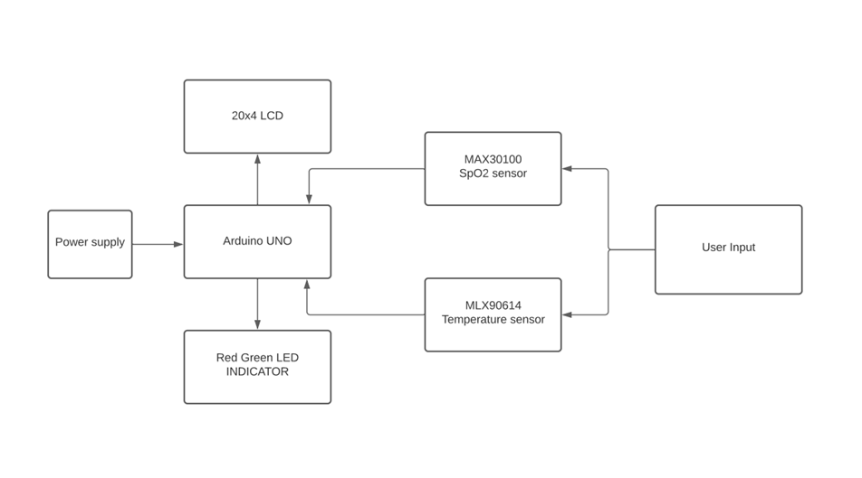
Block Diagram

Slide 5
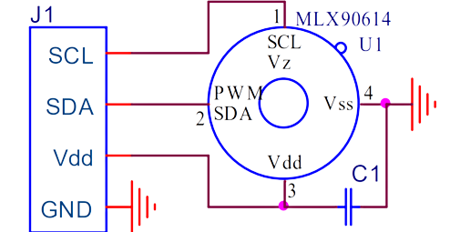
MLX90614 Non contact temperature sensor
The MLX90614 is an IR temperature sensor for non- contact temperature measurements.
Object Temperature Range: -70° C to 382.2°C
Ambient Temperature Range: -40° C to 125°C
Distance between object and sensor: 2cm-5cm (approx.)

Slide 6
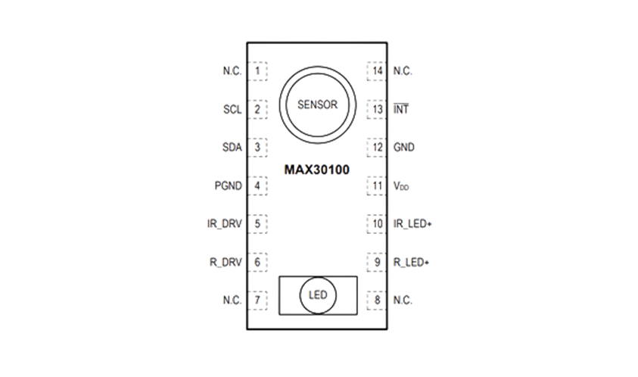
MAX30100 Pulse Oximeter Sensor
The MAX30100 is an integrated pulse oximetry and heart rate monitor sensor solution.
It combines two LEDs, a photodetector, optimized optics, and low-noise analog signal processing to detect pulse oximetry and heart-rate signals.
The MAX30100 operates from 1.8V and 3.3V power supplies and can be powered down through software with negligible standby current, permitting the power supply to remain connected at all times.

Slide 7
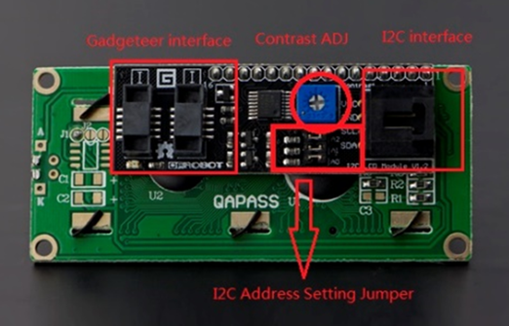
20x04 LCD
This is a 20x4 LCD display module with high speed I2C interface. It is able to display 20x4 characters on two lines, white characters on blue background.
Generally, LCD display will run out of Arduino pin resource
It needs 6 digital pins and 2 power pin for a LCD display . It is using I2C communication interface, With this I2C interface, only 2 lines (I2C) are required to display the information.
It will save at least 4 digital / analog pins on Arduino. All connector are standard XH2.54 (Breadboard type). You can connect it with jumper wire directly.

Slide 8
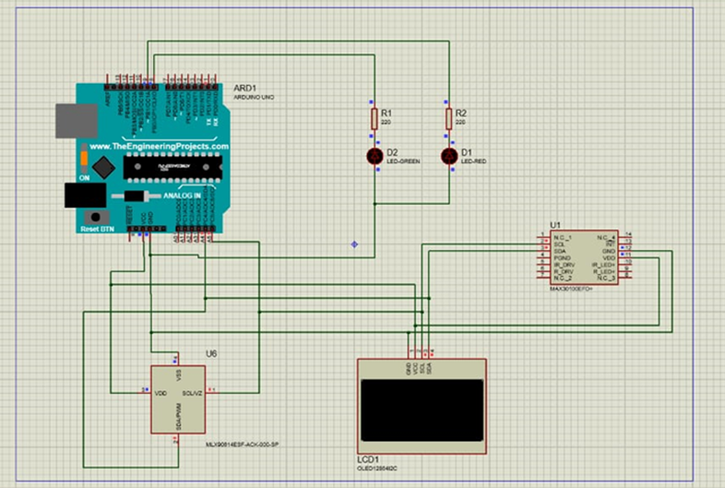
Circuit Diagram PROTEUS Software

Slide 9
Working
Turn on Arduino by connecting it to the laptop.
Gently place the finger on the MAX30100 sensor.
The value of Spo2 Level will get printed on the LCD display.
If the spo2 level is greater than or equal to 95% then the green
LED will glow otherwise the red LED will grow as a indicator.
Now gently hold the forehead toward the MLX90614 sensor to get the temperature reading.
The reading will be displayed on the LCD on the successful attempt and If the temperature exceeds 37 degree Celsius then the red LED will glow otherwise green LED will Glow to indicate safe temperature condition

Slide 10
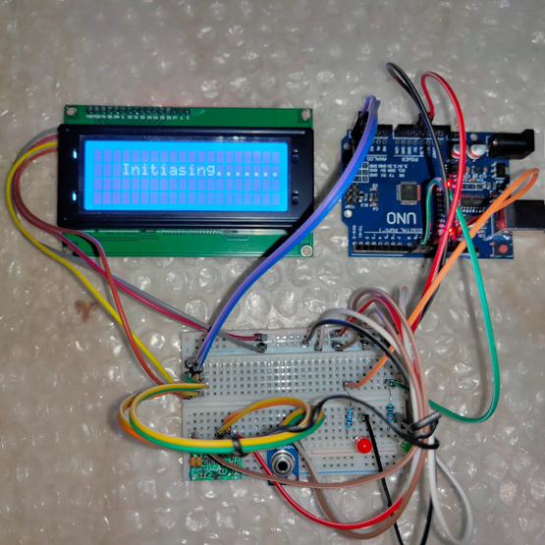
Working Model

Slide 11
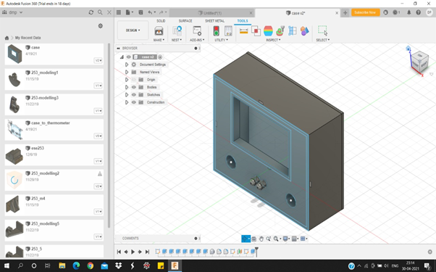
3D Model Autodesk Fusion 360

Slide 12
Applications
We can use this prototype at the entrance of hospital, school, malls , etc. to measure the spo2 level and temperature of person before entrance to ensure he or she is physically alright
It is self checking system which reduces risk of spreading the virus.

Slide 13
Conclusion and Future Scope
The project objective has been successfully achieved where the sensors were successfully interfaced.Overall, the prototype is cost effective, easy to operate, portable and durable.
In future we are willing to enhance our prototype by connecting it to the liquid hand sanitizer dispenser. This will surely improve the quality of measurement and the overall process will become more convenient.

Slide 14
Thank You

